Slide 1

Computer Systems Forensic Analysis
AFSC
Obtaining Evidences
Artur Varanda
School Year 2021-2022

Slide 2
INTRODUCTION
It is normal forensic practice to remove a hard drive from a computer, write-block it and then image that hard drive
But sometimes that is not possible:
  some thin laptops have SSD chips soldered to the motherboard
  the storage device has a non standard data interface and the examiner doesn’t have the appropriate connector:
    in these cases the imaging of the storage device needs to be done with the drive connected to the computer;
Use a forensic boot device on the computer:
boot diskette, bootable CD-ROM/DVD, or bootable USB device
  to ensure the storage drive is not altered either during the boot or the acquisition phase.

Slide 3
INTRODUCTION
The normal startup of a computer alters data on the primary storage drive during the boot process
  it is required to protect the integrity of the original evidence
  we must modify the start-up process in order to prevent any changes to the data on the storage drive
Boot process
the normal boot process begins within the computer’s hardware and moves to the boot device
there are no changes made until the computer transfers control to the boot device

Slide 4
BOOT PROCESS
Boot process steps
most systems have 2 phases:
  configure and start the hardware
  find the operating system and run it
boot code – machine instructions used by the computer
when it is starting when power is applied to a CPU:
it reads instructions from a specific location in memory – typically ROM
the instructions in ROM force the system to probe for and configure hardware
then searches for a device that may contain additional boot code
disks reserve space for boot code, but it isn’t always used
its boot code is executed, and attempts to locate and load an operating system
the process after the bootable disk is found is platform-specific

Slide 5
BOOT PROCESS
Boot code characteristics
has a specific location
the instructions are in machine code
  0xB400 // machine code
  MOV AH,00 // machine code representation in Assembly
on a storage device it is difficult to distinguish random data from machine code

Slide 6
BOOT PROCESS
Systems with BIOS (Basic Input/Output System):
BIOS boots by reading the first sector on a hard disk and executing it
which has space limitations
this boot sector code in turn locates and runs additional code in the first sector of the partition
which locates and loads the actual operating system

Slide 7
SECURE BOOT PROCESS
UEFI (Unified Extensible Firmware Interface)
boots by loading EFI program files (with .efi filename extensions)
stored in a special disk partition, known as the EFI System Partition (ESP)
it can read files from a partition on the hard disk
it is not limited to the size of the first sector
it allows booting OS on disks with more than 2TB
  regardless of the CPU architecture
it supports graphics user interfaces on startup
secure boot – is a feature of UEFI
  the boot code must be digitally signed to prevent the installation of malware in the boot code
  the examiner must use a forensic boot device that supports secure boot

Slide 8
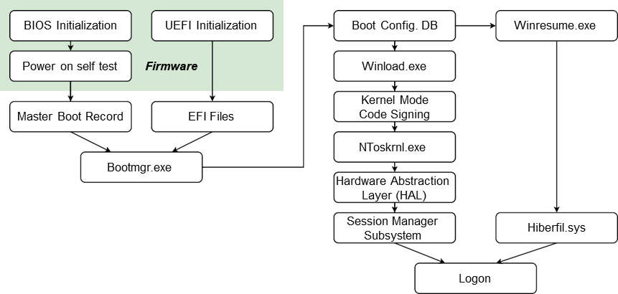
WINDOWS BOOT PROCESS

Slide 9
FORENSIC BOOT TOOLS
Forensic Boot Tools

Slide 10
FORENSIC BOOT – BOOTABLE DISKETTE
DOS boot disk (obsolete, but some times required)
there are three files required to boot a computer into MS-DOS:
  O.SYS, MSDOS.SYS and COMMAND.COM
if present are also used in the boot process:
  DRVSPACE.BIN or DBLSPACE.BIN, CONFIG.SYS and AUTOEXEC.BAT
How to create a forensic bootable diskette:
on the command line of Windows 98: format a: /U /S
  /U unconditional format
  /S copy the necessary system files over to the diskette, in order to make it a boot disk
then remove every file from the diskette except the mandatory three (see above)
remove special attributes from the files to be deleted: attrib -H -R -S filename
  later, it is possible to customize the forensic boot disk by adding CONFIG.SYS and AUTOEXEC.BAT files
  write-blocking utilities and other forensic tools

Slide 11
FORENSIC BOOT – BOOTABLE DISKETTE
If you don’t have a Windows 98 running
HP makes an easy to use utility called HP USB Disk Format Tool, which includes a “Create a DOS Startup Disk” option
It’s available for free download at http://www.19systems.net/HP-USB-Tool-v2.1.8.exe along with the Windows 98/DOS boot files http://www.19systems.net/Win98-Boot-Files.zip
once the bootable diskette is created follow the same procedures to make it “forensic”:
remove every file from the diskette except the mandatory three O.SYS, MSDOS.SYS and COMMAND.COM
  later, it is possible to customize the forensic boot disk by adding CONFIG.SYS and AUTOEXEC.BAT files
  write-blocking utilities and other forensic tools

Slide 12
BOOTABLE CD-ROMS – LINUX BASED
There are many Linux based bootable CD-ROMs (or Live CDs) with forensic tools, such as:
Paladin (www.sumuri.com) – linux distro with many forensic GUI tools, including Autopsy
DEFT (Digital Evidence & Forensic Toolkit https://www.deftlinux.it/index.html) is a customized distribution of the Ubuntu live Linux CD
Caine (Computer Aided INvestigative Environment https://www.caine-live.net) is an Italian GNU/Linux live distribution created as a Digital Forensics project
Kali Linux (https://www.kali.org) is an open-source, Debian-based Linux distribution geared towards various information security tasks, such as Penetration Testing, Security Research, Computer Forensics and Reverse Engineering
Create a bootable CD-ROM:
find and download the ISO file, e. g. Paladin-6.1.iso
use a CD-burning program to write the ISO file to the CD
Linux based bootable CD-ROM disadvantage
Not all first responders are comfortable using Linux

Slide 13
BOOTABLE CD-ROMS – WINDOWS BASED
There are several Windows based bootable CD-ROMs (or Live CDs):
WinFE (Windows Forensic Environment) created by Brett Shavers – Free
System Acquisition Forensic Environment (SAFE) Boot Disk by Forensic Soft – Commercial
Gargoyle Investigator by Wetstone – Commercial
WinFE (https://www.winfe.net)
Advantages
it’s free, but requires a Windows license
runs windows software, e. g. FTK Imager, RegRipper, . . . can be customized
Disadvantages
requires configuration on the part of the user prior to use
must be built to customize with your own set of tools

Slide 14
BOOTABLE USB DEVICES
Nowadays, most computers don’t have CD/DVD drives.
Tools to create a bootable USB device:
on Windows
UNetBootIn (https://unetbootin.github.io/)
Rufus (http://rufus.akeo.ie/)
on Linux
Gnome Multi-Writer (https://gitlab.gnome.org/GNOME/gnome-multi-writer)
Etcher – USB and SD Card Writer (https://etcher.download/)
UnetBootIn for Linux (https://unetbootin.github.io/linux_download.html)
DD command line tool: sudo dd bs=4M if=input.iso of=/dev/sdx conv=fdatasync (replace sdx by the drive letter of the USB device)

Slide 15
FORENSIC SORTING TOOLS
Forensic Sorting Tools

Slide 16
SORTING TOOLS – WINDOWS REGISTRY
RegistryReport
homepage: https://www.gaijin.at/en/files?dir=old-software
requires the SAM, SOFTWARE, SYSTEM and NTUSER.DAT registry files
doesn’t process the registry files of the running operating system
shows information about (Windows 2000 or higher)
  the operating system
  installed software
  the last user activity
  the user settings
  and many other details
the amount of information for each category can be configured in the settings dialog
it allows to save, print and search the generated report

Slide 17
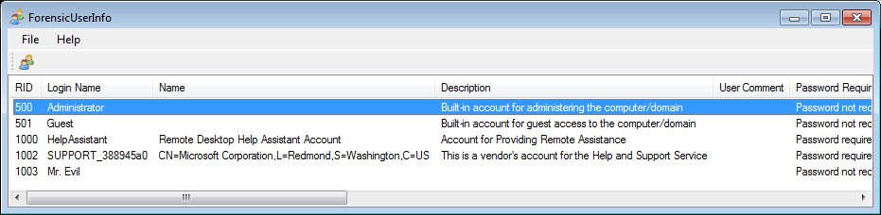
SORTING TOOLS – WINDOWS REGISTRY
ForensicUserInfo
homepage: https://github.com/woanware/ForensicUserInfo
requires the SAM, SOFTWARE and SYSTEM files
extracts the following information:
RID, Login Name, Name, Description, User Comment
LM Hash, NT Hash
Last Login Date, Password Reset Date, Account Expiry Date, Login Fail Date
Login Count, Failed Logins, Profile Path, Groups

Slide 18
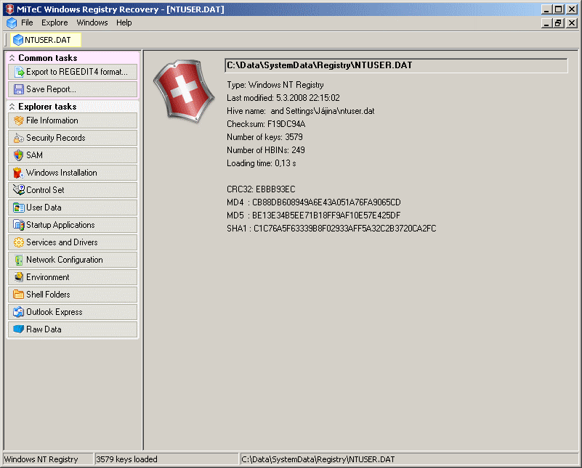
SORTING TOOLS – WINDOWS REGISTRY
Mitec WRR (Windows Registry Recovery)
homepage: http://www.mitec.cz/wrr.html
for crashed machine, registry configuration, data recovery
it allows to explore:
File Information
SAM
Security Record Explorer
Windows Installation
Hardware
User Data
Startup Applications
Services and Drivers
Network Configuration
Windows Firewall Settings
Environment,
Shell Folders
Outlook Express,
Raw Data

Slide 19
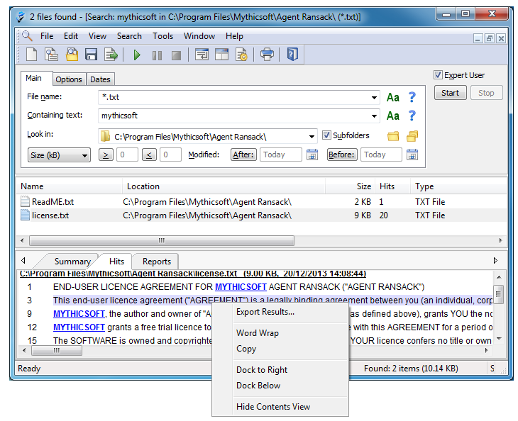
SORTING TOOLS – FILE SEARCH
RanSack
homepage: https://www.mythicsoft.com/agentransack/
free software program for finding files on your PC or network drives
  fast search (less time waiting)
  powerful search capabilities (Boolean expressions, Perl regex)
  supports Microsoft Office and Libre Office files formats

Slide 20
SORTING TOOLS – PORTABLE APPLICATIONS
Portable Forensic Tools
collection of freeware tools, such as:
DataProtectionDecryptor – decrypts passwords of Microsoft Outlook accounts, credentials files of Windows, wireless network keys, passwords in some versions of Internet Explorer, passwords and cookies of Chrome Web browser
JumpListsView – displays the information stored by the ’Jump Lists’
Windows File Analyzer – decodes and analyzes to provide cached information
BinText – extracts strings from binary files
Data Converter – converts numbers, hexadecimal values or dates
EXIF Viewer – displays EXIF informations from JPEG images
eMule MET Viewer – shows various information from the eMule
. . .
to find more portable tools: https://www.portablefreeware.com

Slide 21
SORTING TOOLS – MULTI-PROPOSE TOOL
FTK Imager
homepage: https://www.exterro.com/ftk-imager
very powerful and user-friendly tool
runs as portable application, ideal to include in WinFE
search files
look for deleted files
copy files (e. g. cache and registry files)
identify ADS (Alternate Data Stream)
acquire storage devices and RAM
mount E01 files
. . .

Slide 22
Forensic Acquisition

Slide 23
INTRODUCTION
Data Acquisition
typically occurs in the “system preservation” phase
although it might also occur on a running system
this is an import phase
if not done properly data can be lost forever
it must be done in a way that does not undermine its legal validity

Slide 24
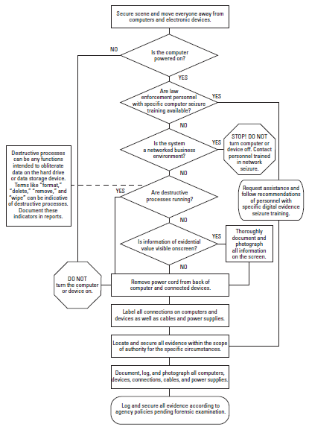
INTRODUCTION
What to do if:
the computer is off → remove power cord
the computer is on:
  take a picture of the screen
  are destructive processes running? → remove power cord
  do a memory dump and get network connections status → this may destroy or contaminate evidences
    when you cannot turn off a server
    to get passwords or encryption keys stored in RAM
    to monitor malicious software network activities
Source: Electronic Crime Scene Investigation: A Guide for First Responders, Second Edition (U.S. Department of Justice)

Slide 25
INTRODUCTION
Information analysis layers on storage media:
physical – from the first to the last bit of the storage media
volume – it is not possible to get unallocated sectors, partition table or hidden areas
file – file copies (e. g. backup tools) less likely to retrieve deleted files
application – each application has its own encoding or file format
The higher the acquisition layer, the less information can be retrieved
Whenever possible, data acquisition should be made at the physical level.
Other media:
network and volatile memory
each medium as its own recommend procedures

Slide 26
INTRODUCTION
Copying storage media
the bigger the block size, the faster the acquisition,
but if there are sectors with errors, the all block will be invalid
the acquisition block size should match the sector size
  for HDD the sector size is 512 bytes
  for SSD sector size depends on the brand, model and capacity
data acquisition should include the complete storage medium (physical level)
  including unallocated sectors, and
  hidden areas: HPA or DCO – in this case 2 acquisitions are recommended
  one with the hidden area in place, and another with the hidden areas disabled

Slide 27
FORENSIC DATA ACQUISITION
Data acquisitions from storage media
make a storage medium forensic copy
requires another storage medium of equal or bigger size, although many tools can create compressed images files
reading the data
through the BIOS – old BIOS don’t support large storage drives → may report wrong drive size
direct access – the best choice, but not supported by all tools

Slide 28
FORENSIC DATA ACQUISITION
Post mortem versus alive data
acquisition post mortem
  the OS is shutdown
  suspect hardware can be used using a trusted OS to boot it
    Caution: new PCs boot too fast and we might not be able to change boot order
  the NSA scandal showed that we cannot always trust the hardware
    spyware inside HDDs’ firmware
  although it is less likely to happen than software tampering
  alive
  the OS is running and used to perform the acquisition
    there is the risk of the OS have been tampered and return wrong data
    e. g. rootkits that hide processes and files to avoid detection
  online acquisition should be performed only in special situations

Slide 29
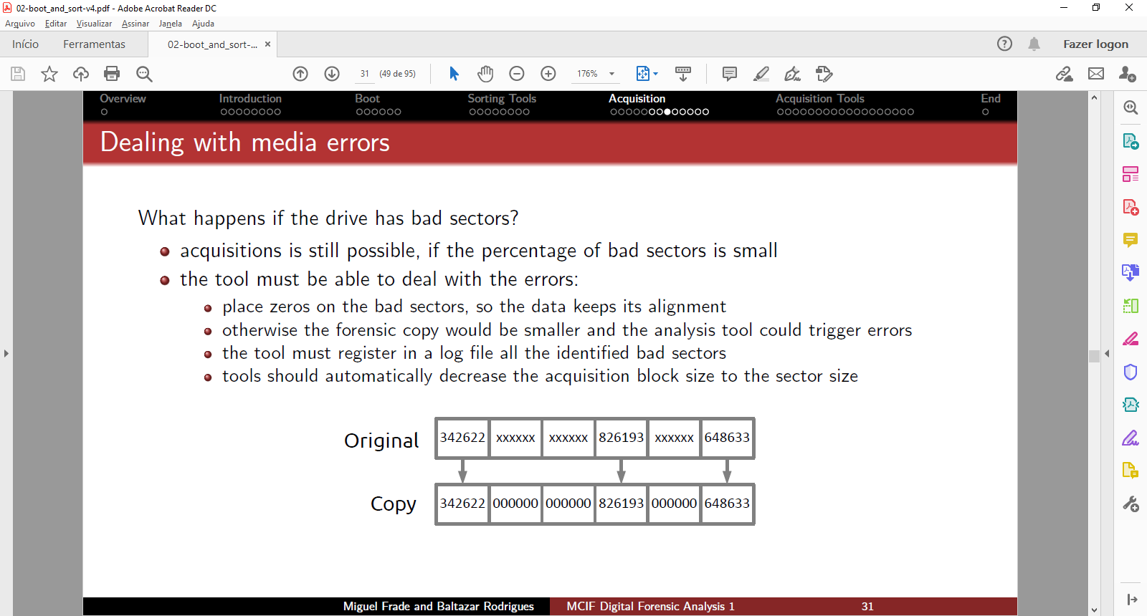
DEALING WITH MEDIA ERRORS
What happens if the drive has bad sectors?
acquisitions is still possible, if the percentage of bad sectors is small
the tool must be able to deal with the errors:
  place zeros on the bad sectors, so the data keeps its alignment
  otherwise the forensic copy would be smaller and the analysis tool could trigger errors
  the tool must register in a log file all the identified bad sectors
  tools should automatically decrease the acquisition block size to the sector size

Slide 30
HIDDEN AREAS
Host Protected Area (HPA)
this area should be copied also, it may contain hidden data
few tools support reading HPA
we can use the hdparm tool to temporarily access it (a reboot will restore the HPA)
as a precaution measure, we should make first one forensic copy with HPA in place
Device Configuration Overlay (DCO)
the removal of the DCO is permanent, so as a precaution measure, we should make first one forensic copy with DCO in place
few tools support reading DCO areas
  list of tools is available in https://forensicswiki.xyz
Tableau Imager is able to identify and read both HPA and DCO

Slide 31
WRITE PROTECTION OF EVIDENCE MEDIA
Write blockers stop any write operation to the storage media under investigation
Hardware
specific for each medium interface: ATA, SATA, SCSI, Firewire (IEEE 1394) or USB
stops write operations regardless of the used OS
specialized hardware provides better acquisition performance
some hardware works like a proxy and monitors all operations
this is the best option, but it is also the most expensive
list of tests on hardware write blockers:
    https://www.nist.gov/itl/ssd/software-quality-group/computer-forensics-tool-testing-program-cftt/cftt-technical/hardware
Software
  this is the less expensive solution
  but may be less effective, some apps can bypass the software write block
  list of tests on software write blockers:
      https://www.nist.gov/itl/ssd/software-quality-group/computer-forensics-tool-testing-program-cftt/cftt-technical/software

Slide 32
HOW TO STORE THE ACQUIRED DATA?
There are 2 main approaches to acquire
data: cloning
it is recommend to use drives of the same size
if the clone driver is bigger, where the clone data ends?
it is highly recommended to zero out first the drive before cloning
drive geometry of the clone might be different
some OS, namely Windows, by default auto mount drives, so you need write blockers to analyze the clones
imaging the drive – the most common approach
it is not vulnerable to auto mount by the OS
an image will always be mounted as read only, no need for a write blocker
it is possible to simulate read/write operation
the changes will be stored in a cache file, leaving the original intact
this way one drive can store image files from several different media
the image file can be split into smaller files to fit in a DVD

Slide 33
IMAGE FILE ACQUISITION
There are several image formats for acquired data:
raw image – most flexible format, supported by all analysis software
raw image + external metadata – like the raw image, but adds another file with description data, hash values and time
embedded image – proprietary format, the metadata is embedded inside the image
some image file formats support compression
  save storage space, but the acquisition process takes longer to complete
  not all tools support compressed image files – it might be required to uncompress first
  good solution for long term storage of the image files
Acquisition
local acquisition – implies physical access to the storage drive
remote acquisition
when it is not possible to have physical access to the storage drive
when there are no adequate adapters for the storage medium
this process is slower, usage of compression is recommended
if there are no full control of the network encryption should be used

Slide 34
HASH VALUES
To guarantee integrity, hash values should be stored
hash black of small size to prevent a single error to invalidate the all drive image
e. g. the same size of the acquisition block
in a RAW file hash values are stored in a separate file
I recommend to do a digital signature on the hash values files
Why do you think this is good practice?
Digital signatures
best tool is GnuPG - https://www.gnupg.org/
if possible, use also a time stamping server

Slide 35
FORENSIC ACQUISITION TOOLS
Tools for data acquisition on storage media there are many tools
Windows – with graphical user interface
FTK imager, Tableau imager, . . .( https://www.exterro.com/ftk-imager)
Linux – many are command line
GUI – Guymager (https://guymager.sourceforge.io/)
CMD – ewftools, dd and derived tools: dcfldd, dc3dd, ddrescue, dd rescue, rdd, . . .
Computer Forensic Tool Testing (CFTT) project
  develops test-cases for digital forensic tools
  tests the tools and publishes the results
      https://www.nist.gov/itl/ssd/software-quality-group/computer-forensics-tool-testing-program-cftt

Slide 36
LINUX CMD – EXPERT WITNESS FORMAT (EWF)
Expert Witness Format (EWF)
proprietary format from EnCase tool, supports compression
file extension: E01, E02, . . .
there are also open-source tools: apt-get install ewf-tools
ewfacquire – acquire drive data locally
ewfacquirestream – acquire drive data remotely
ewfmount – mount EWF images (will be mounted as a RAW file)
ewfexport – convert image file formats
ewfinfo – get info from a an EWF image file
ewfrecover – tries to recover corrupted EWF files
ewfverify – validate EWF file integrity → very important before start an analysis
# Install EWF tools
# EnCase → RAW
sudo apt install ewf-tools
ewfexport -f raw filename.E??

Slide 37
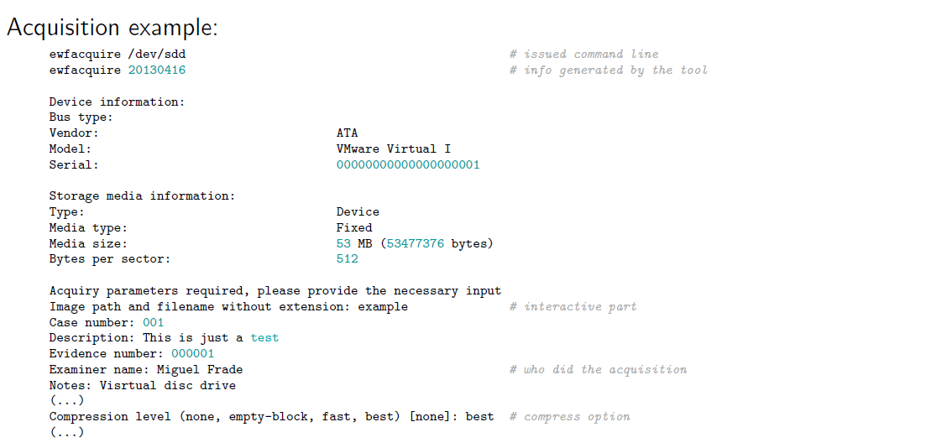
LINUX CMD – EXPERT WITNESS FORMAT (EWF)

Slide 38
LINUX CMD – EXPERT WITNESS FORMAT (EWF)
Example
download EWF files:
    http://downloads.digitalcorpora.org/corpora/drives/nps-2008-m57-jean/nps-2008-jean.E01
    http://downloads.digitalcorpora.org/corpora/drives/nps-2008-m57-jean/nps-2008-jean.E02
  get info: ewfinfo nps-2008-jean.E0*
  mount the EWF image is a 2-step process:
    mount the EWF to be seen as RAW disk
    mount the raw disk
  Tools:
    Windows: FTK Imager (very simple)
    Linux has several options:
      ewfmount or xmount + mount → requires sudo, but allows to see MFT as a file
      xmount + udisksctl → the safest option, can be done by a regular user

Slide 39
LINUX CMD – EXPERT WITNESS FORMAT (EWF)
Mount EWF image with ewfmount on Linux
1. sudo ewfmount nps-2008-jean.E?? /mnt/raw
maps as a RAW file
read only, it is not possible to emulate write operations
2. sudo mount -t ntfs -o
ro,loop,show sys files,streams interface=windows,offset=$[63*512] /mnt/raw/ewf1/mnt/loop/
mounts file system in the RAW image
show sys files – allows to see NFTS structures as files
streams interface=windows – allows access to Alternate Data Streams (ADS) data
offset=$[63*512] – beginning of the partition to mount (in bytes)

Slide 40
LINUX CMD – EXPERT WITNESS FORMAT (EWF)
Mount EWF with xmount on Linux (without sudo)
1. xmount --in ewf nps-2008-jean.E?? --out raw --cache cachefile /mnt
maps EWF as a RAW file
xmount emulates write operations using a cache file
2. udisksctl loop-setup -f /mnt/nps-2008-jean.dd
creates a loop device for each partition
ls /dev/loop0* → check how many partitions were identified
this command requires the user to belong to the fuse and disk groups:
  sudo usermod -a -G fuse username
  sudo usermod -a -G disk username
3. udisksctl mount -b /dev/loop0p1
  mount the first partition

Slide 41
LINUX CMD – DCFLDD TOOL
dcfldd
developed by Department of Defense Computer Forensics Lab (DCFL)
forensic tool derivate from the dd command line tool
differences with dd
calculates the hash values and supports md5, sha1, sha256 and sha512
can write the identified bad sectors to a separate file
can aggregate bad sectors errors Had 1,023 ’Input/ouput errors’ between blocks 17-233’
checks the hash values
reports the progress
allows to split the image file in smaller files
to ensure reproducibility bad sectors are written with zeros in the image file
there are many forensic tools derivate from dd
  dc3dd (very similar), ddrescue, dd rescue, rdd, . . .

Slide 42
LINUX CMD - GETTING HELP
To get more info about the dcfldd tool
dcfldd --version → installed version
dcfldd --help → list all the supported options
man dcfldd → man page
I couldn’t find the official homepage of this tool, but you can get more info:
https://forensicswiki.xyz/wiki/index.php?title=Dcfldd
complement with info from https://en.wikipedia.org/wiki/Dd_(Unix)

Slide 43
LINUX CMD – USAGE EXAMPLE
dcfldd if=/dev/sourcedrive hash=md5,sha256 hashwindow=1G md5log=md5.txt sha256log=sha256.txt hashconv=after bs=512 conv=noerror,sync split=10G splitformat=aa of=image.dd
if=/dev/sourcedrive → file that represents the drive to acquire
hash=md5,sha256 → request md5 and sha256 hash values
hashwindow=1G → calculate hash values at each 1 GB
md5log=md5.txt sha256log=sha256.txt → files name to store hash values
hashconv=after → calculate hash values after error checking
bs=512 → use block size of 512 bytes
conv=noerror,sync → noerror – doesn’t stop in case of reading errors, sync – keeps image synced when errors show up
split=10G → split RAW image into 10 GB files
of=image.dd → base filename
splitformat=aa → format of individual filenames image.dd.aa, image.dd.ab, . . .

Slide 44
LINUX CMD – HASH VALUES FILE CONTENT
cat SHA256.txt
0 - 1048576: 1756ad07245b68744644fa147bbed4dbf5b148ba61839d01e7421ff20098c681
1048576 - 2097152: 908348ee7e44372531d1311143d9ef3a2829fe30f93831b5a81e450a9d366168
2097152 - 3145728: 30e14955ebf1352266dc2ff8067e68104607e750abb9d3b36582b8af909fcb58
3145728 - 4194304: 30e14955ebf1352266dc2ff8067e68104607e750abb9d3b36582b8af909fcb58
4194304 - 5242880: 30e14955ebf1352266dc2ff8067e68104607e750abb9d3b36582b8af909fcb58
5242880 - 6291456: 30e14955ebf1352266dc2ff8067e68104607e750abb9d3b36582b8af909fcb58
...
52428800 - 53477376: 30e14955ebf1352266dc2ff8067e68104607e750abb9d3b36582b8af909fcb58
Total (sha256): 5767d9dcd2e48b3a0dce1b9a143ecf7a664364660637c5f348d1054afb4a1784

Slide 45
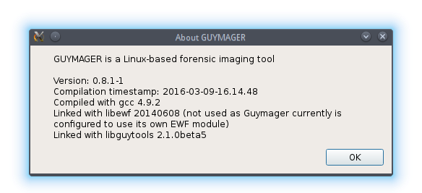
LINUX GUI – GUYMAGER
Guymager https://guymager.sourceforge.io
very user friendly
suppports RAW, EWF and AFF file formats
faster than known commercial imagers running under Windows.
does not support logical acquisitions:
  /etc/guymager/guymager.cfg – default configuration file, do not change!
  /etc/guymager/local.cfg – do all your configuration in this file, e. g. EwfCompression=BEST

Slide 46
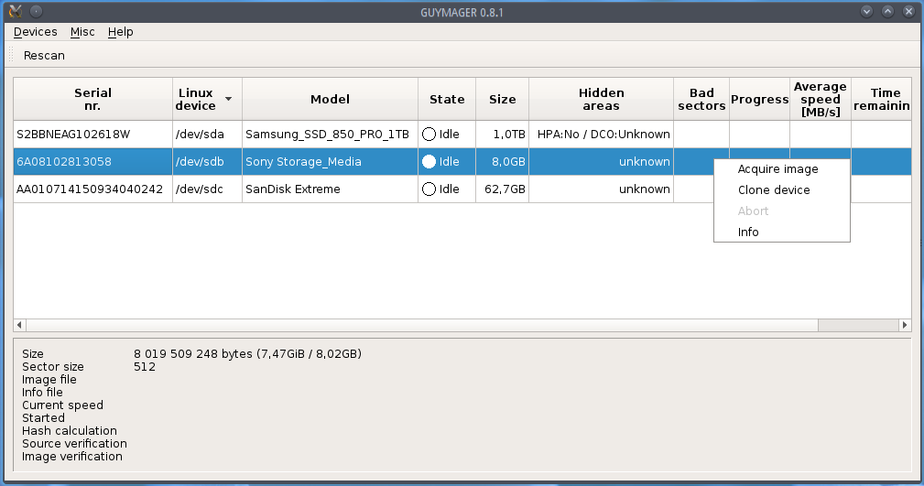
LINUX GUI – GUYMAGER
Recommended option for Linux

Slide 47
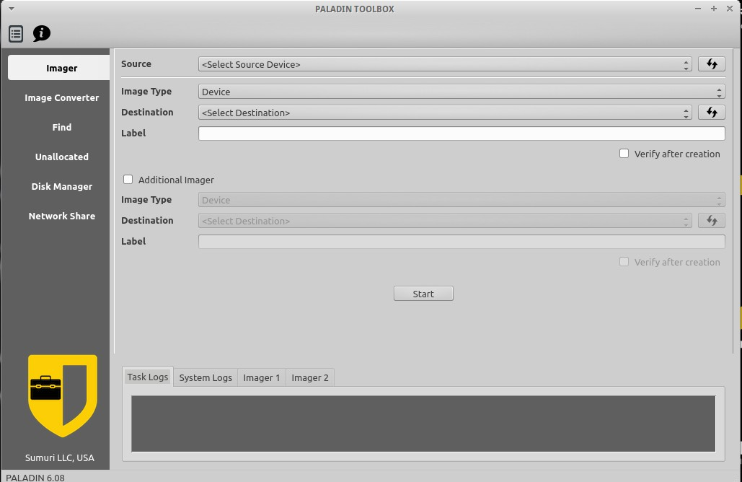
LINUX GUI – PALADIN TOOLBOX
Paladin Toolbox https://sumuri.com/software/paladin
included in the live Linux Paladin from Sumuri (forensics distro)
free, but not open source and requires registration to download
supports logical acquisitions, which is the recommend option for SSDs

Slide 48
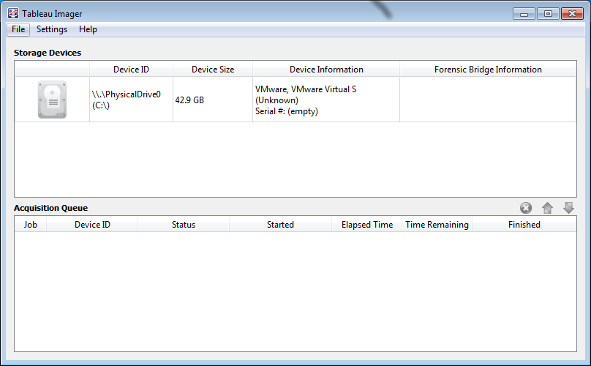
WINDOWS – TABLEAU IMAGER
Tableau Imager https://security.opentext.com/tableau/hardware/details/tx1
works only with Tableau write blockers
free, but not open source and requires registration to download
does not support logical acquisitions, which is the recommend option for SSDs

Slide 49
WINDOWS – FTK IMAGER
FTK Imager https://accessdata.com/product-download/ftk-imager-version-4-5
Create forensic images of local hard drives, CDs and DVDs, thumb drives or other USB devices, entire folders, or individual files from various places within the media
Preview files and folders
Preview the contents of forensic images
Mount an image for a read-only view
Export files and folders from forensic images
See and recover files that have been deleted from the Recycle Bin
Create hashes of files to check the integrity of the
Generate hash reports for regular files and disk images
Lite version runs as portable application
Recommended option for windows

Slide 50
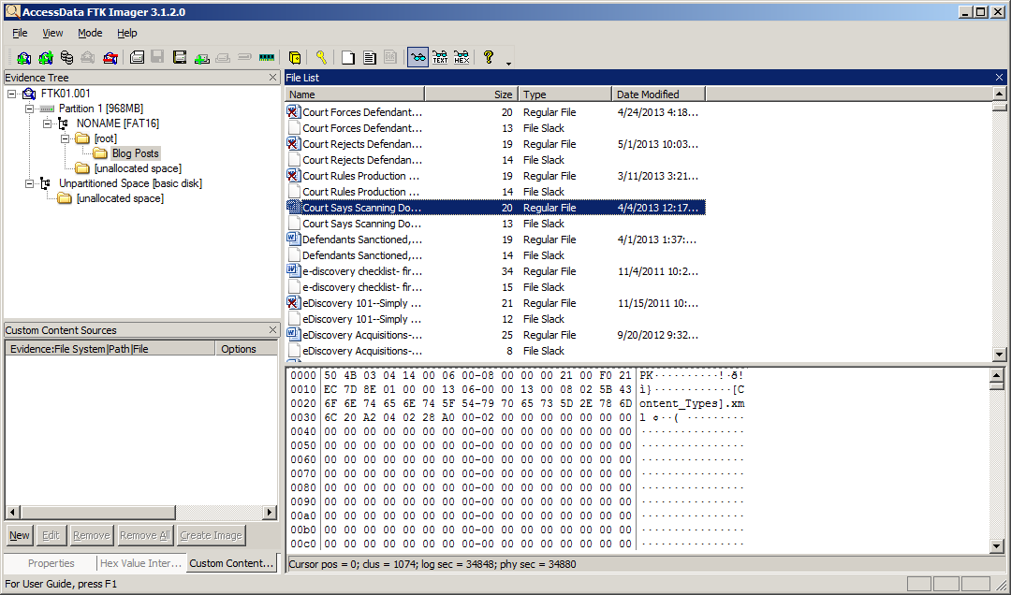
WINDOWS – FTK IMAGER

Slide 51
EXERCISE
Lab 01 - Build WinFE and boot a virtual machine with it

Slide 52
EXERCISE
Lab 02 – Create a Forensic Image
Without extracting the virtual machine assigned to your team, add it as an evidence source to FTK Imager running on your computer
Create a .e01 forensic image from the virtual machine with FTK Imager
make sure you have enough disk space for the acquisition
split into 4 096 MB files to fit into FAT32 file systems if needed
enable compression, it’s slower, but takes less space
validate the forensic image

Slide 53

ANY QUESTIONS?

